Slide 1
AVR Microcontroller
Microprocessor Course
Chapter 4
AVR I/O PORT PROGRAMMING
Aban 1401

Slide 2
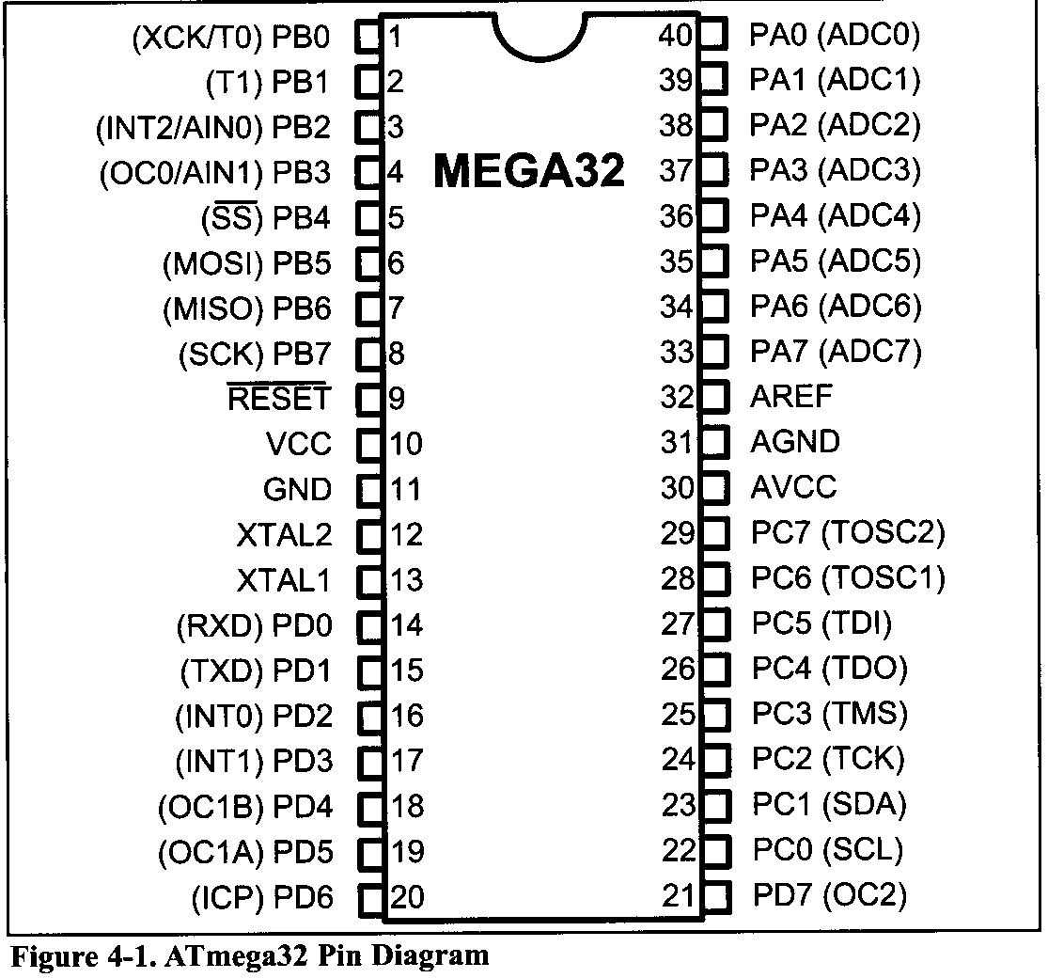
AVR I/O PORT PROGRAMMING 4.1 I/O PORT PROGRAMMING IN AVR
Examine Figure 4-1 for the ATmega32 40-pin chip. A total of 32 pins are set aside for the four ports PORTA, PORTB, PORTC, and PORTD. The rest of the pins are designated as VCC, GND, XTAL1, XTAL2, RESET, AREF, AGND, and AVCC.

Slide 3
AVR I/O PORT PROGRAMMING 4.1 I/O PORT PROGRAMMING IN AVR
I/O port pins and their functions
The number of ports in the AVR family varies depending on the number of pins on the chip.
The 8-pin AVR has port B only,
while the 64-pin version has ports A through F,
and the 100-pin AVR has ports A through L, as shown in Table 4-1.
The 40-pin AVR has four ports.
They are PORTA, PORTB, PORTC, and PORTD.
To use any of these ports as an input or output port, it must be programmed.
In addition to being used for simple I/O, each port has some other functions such as ADC, timers, interrupts, and serial communication pins.

Slide 4
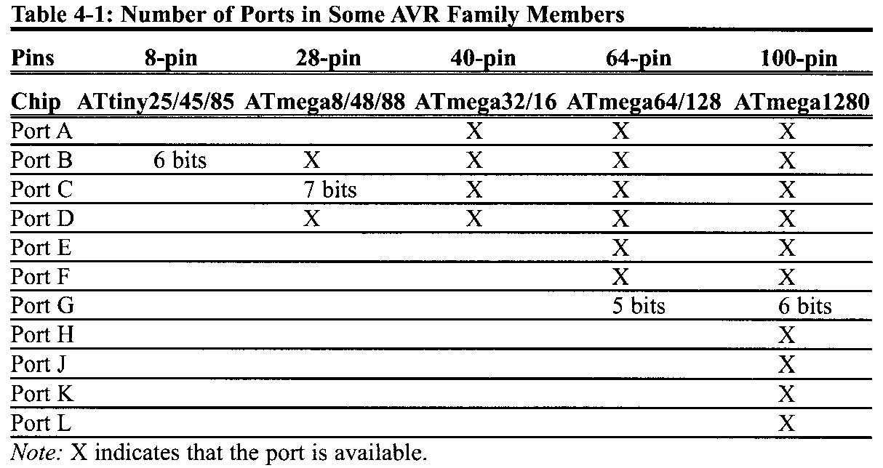
AVR I/O PORT PROGRAMMING 4.1 I/O PORT PROGRAMMING IN AVR
Figure 4-1 shows alternate functions for the ATmega32 pins.

Slide 5
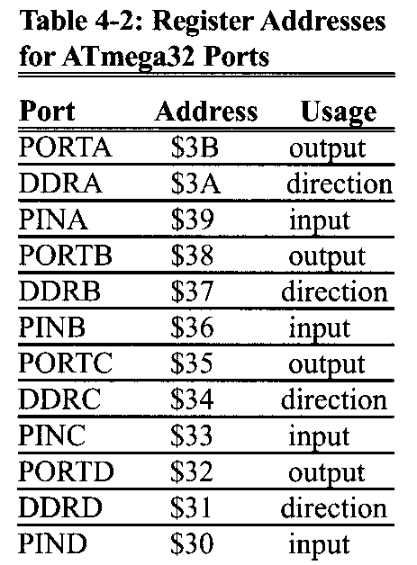
AVR I/O PORT PROGRAMMING 4.1 I/O PORT PROGRAMMING IN AVR
For example, for Port B we have PORTB, DDRB, and PINB. Notice that DDR stands for Data Direction Register, and PIN stands for Port INput pins. Also notice that each of the I/O registers is 8 bits wide, and each port has a maximum of 8 pins; therefore PORTD each bit of the I/O registers affects one of the direction pins

Slide 6
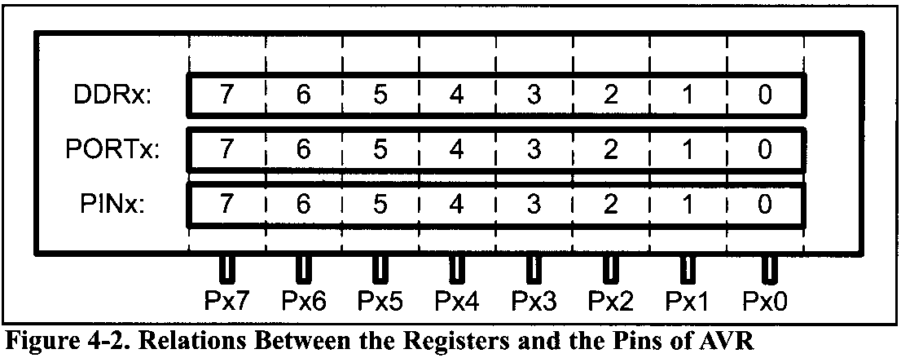
AVR I/O PORT PROGRAMMING 4.1 I/O PORT PROGRAMMING IN AVR
DDRx register role in outputting data
The DDRx I/O register is used solely for the purpose of making a given port an input or output port. For example, to make a port an output, we write 1s to the DDRx register. In other words, to output data to all of the pins of the Port B, we must first put 0b11111111 into the DDRB register.

Slide 7
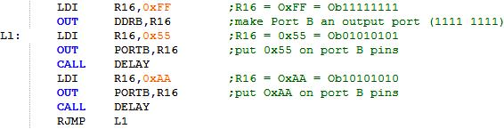
AVR I/O PORT PROGRAMMING 4.1 I/O PORT PROGRAMMING IN AVR
The following code will toggle all 8 bits of Port B forever with some time delay between “on” and “off” states:
It must be noted that unless we set the DDRx bits to one, the data will not go from the port register to the pins of the AVR. This means that if we remove the first two lines of the above code, the 0x55 and 0xAA values will not get to the pins. They will be sitting in the I/O register of Port B inside the CPU.

Slide 8
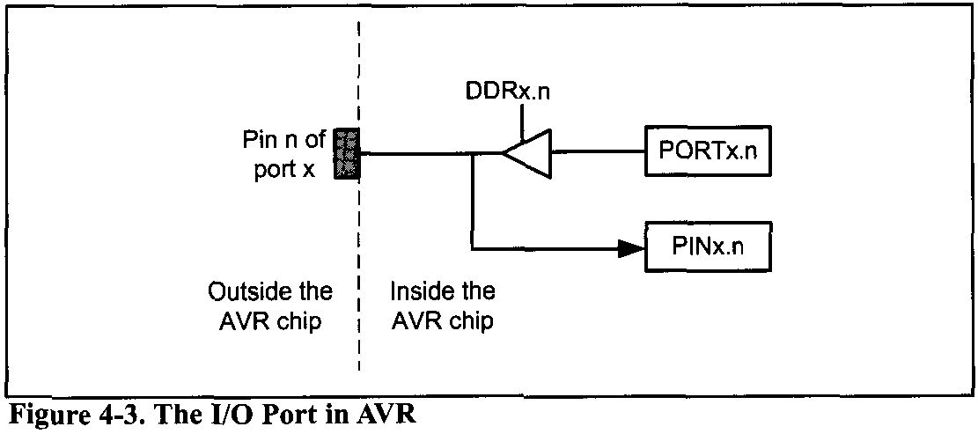
AVR I/O PORT PROGRAMMING 4.1 I/O PORT PROGRAMMING IN AVR
DDR register role in inputting data
To make a port an input port, we must first put 0s into the DDRx register for that port, and then bring in (read) the data present at the pins.
Notice that upon reset, all ports have the value 0x00 in their DDR registers. This means that all ports are configured as input.

Slide 9
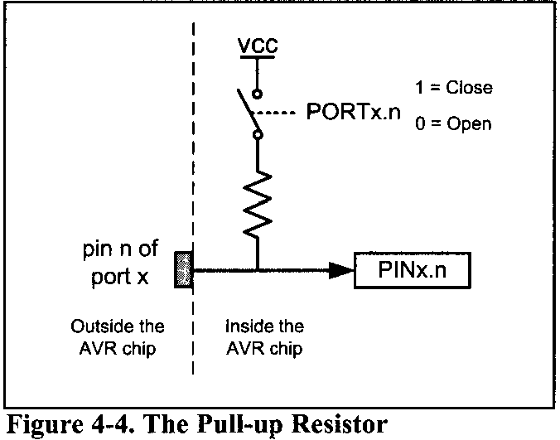
AVR I/O PORT PROGRAMMING 4.1 I/O PORT PROGRAMMING IN AVR
PIN register role in inputting data
To read the data present at the pins, we should read the PIN register. It must be noted that to bring data into CPU from pins we read the contents of the PINx register, whereas to send data out to pins we use the PORTx register.
There is a pull-up resistor for each of the AVR pins. If we put 1s into bits of the PORTx register, the pullup resistors are activated. In cases in which nothing is connected to the pin or the connected devices have high impedance, the resistor pulls up the pin.

Slide 10
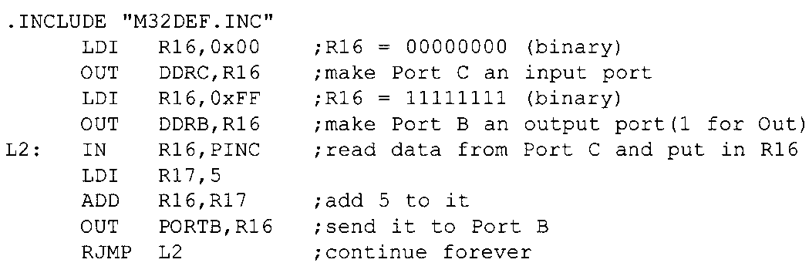
AVR I/O PORT PROGRAMMING 4.1 I/O PORT PROGRAMMING IN AVR
The following code gets the data present at the pins of port C and sends it to port B indefinitely, after adding the value 5 to it:

Slide 11
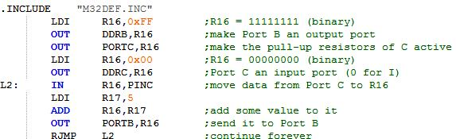
AVR I/O PORT PROGRAMMING 4.1 I/O PORT PROGRAMMING IN AVR
If we want to make the pull-up resistors of port C active, we must put 1s into the PORTC register. The program becomes as follows:

Slide 12
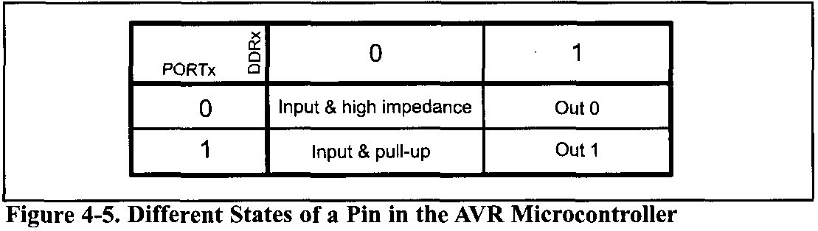
AVR I/O PORT PROGRAMMING 4.1 I/O PORT PROGRAMMING IN AVR
The pins of the AVR microcontrollers can be in four different states according to the values of PORTx and DDRx, as shown in Figure 4-5.
This is one of powerful features of the AVR microcontroller, since most of the other microcontrollers' pins (e.g., 8051) have fewer states.

Slide 13
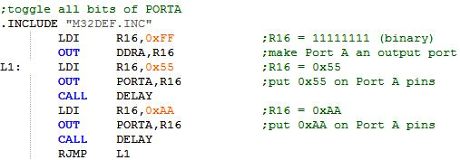
AVR I/O PORT PROGRAMMING 4.1 I/O PORT PROGRAMMING IN AVR
Port A
Port A occupies a total of 8 pins (PA0-PA7). To use the pins of Port A as input or output ports, each bit of the DDRA register must be set to the proper value. For example, the following code will continuously send out to Port A the alternating values of 0x55 and 0xAA:

Slide 14
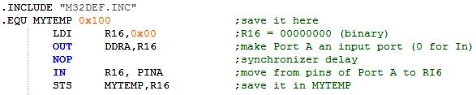
AVR I/O PORT PROGRAMMING 4.1 I/O PORT PROGRAMMING IN AVR
Port A as input
In order to make all the bits of Port A an input, DDRA must be cleared by writing 0 to all the bits. In the following code, Port A is configured first as an input port by writing all 0s to register DDRA, and then data is received from Port A and saved in a RAM location:

Slide 15
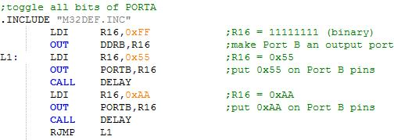
AVR I/O PORT PROGRAMMING 4.1 I/O PORT PROGRAMMING IN AVR
Port B
Port B occupies a total of 8 pins (PB0-PB7). To use the pins of Port B as input or output ports, each bit of the DDRB register must be set to the proper value.
For example, the following code will continuously send out the alternating values of 0x55 and 0xAA to Port B:

Slide 16
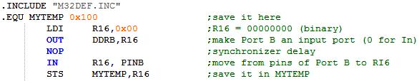
AVR I/O PORT PROGRAMMING 4.1 I/O PORT PROGRAMMING IN AVR
Port B as input
In order to make all the bits of Port B an input, DDRB must be cleared by writing 0 to all the bits. In the following code, Port B is configured first as an input port by writing all 0s to register DDRB, and then data is received from Port B and saved in some RAM location:

Slide 17
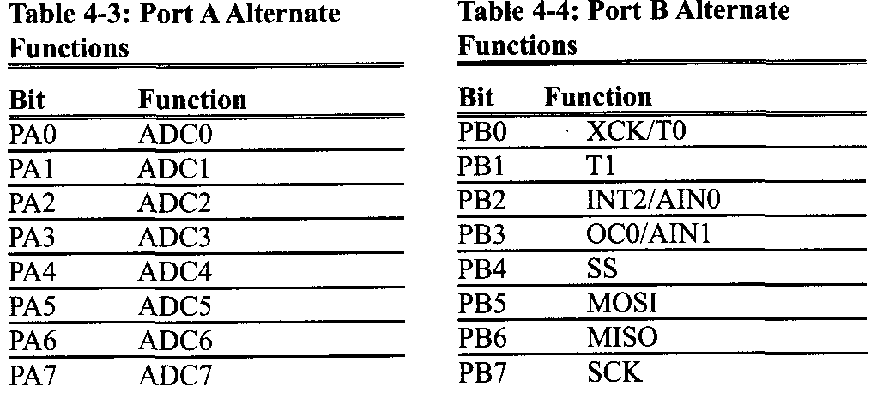
AVR I/O PORT PROGRAMMING 4.1 I/O PORT PROGRAMMING IN AVR
The AVR multiplexes an analog-to-digital converter through Port A to save I/O pins. The alternate functions of the pins for Port A are shown in Table 4-3.
The AVR multiplexes some other functions through Port B to save pins. The alternate functions of the pins for Port B are shown in Table 4-4.

Slide 18
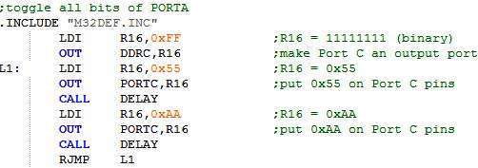
AVR I/O PORT PROGRAMMING 4.1 I/O PORT PROGRAMMING IN AVR
Port C
Port C occupies a total of 8 pins (PCO-PC7). To use the pins of Port C as input or output ports, each bit of the DDRC register must be set to the proper value. For example, the following code will continuously send out the alternating values of 0x55 and 0xAA to Port C:

Slide 19
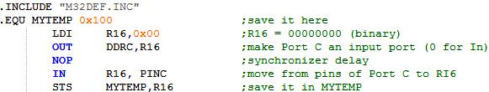
AVR I/O PORT PROGRAMMING 4.1 I/O PORT PROGRAMMING IN AVR
Port C as input
In order to make all the bits of Port C an input, DDRC must be cleared by writing 0 to all the bits. In the following code, Port C is configured first as an input port by writing all 0s to register DDRC, and then data is received from Port C and saved in a RAM location:

Slide 20
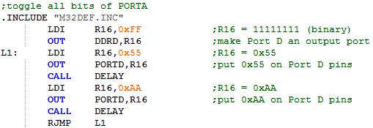
AVR I/O PORT PROGRAMMING 4.1 I/O PORT PROGRAMMING IN AVR
Port D
Port D occupies a total of 8 pins (PD0-PD7). To use the pins of Port D as input or output ports, each bit of the DDRD register must be set to the proper value. For example, the following code will continuously send out to Port D the alternating values of 0x55 and 0xAA:

Slide 21
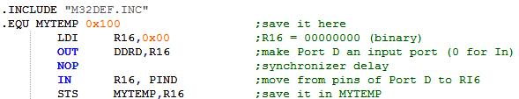
AVR I/O PORT PROGRAMMING 4.1 I/O PORT PROGRAMMING IN AVR
Port D as input
In order to make all the bits of Port D an input. DDRD must be cleared by, writing 0 to all the bits. In the following code, Port D is configured first as an input port by writing all 0s to register DDRD, and then data is received from Port D and saved in a RAM location:
Notes:
In order to make all the bits of Port D an inout. DDRD must be cleared by, writing 0 to all the bits. In the following code, Port D is configured first as an input port by writing all 0s to register DDRD, and then data is received from Port D and saved in a RAM location:

Slide 22
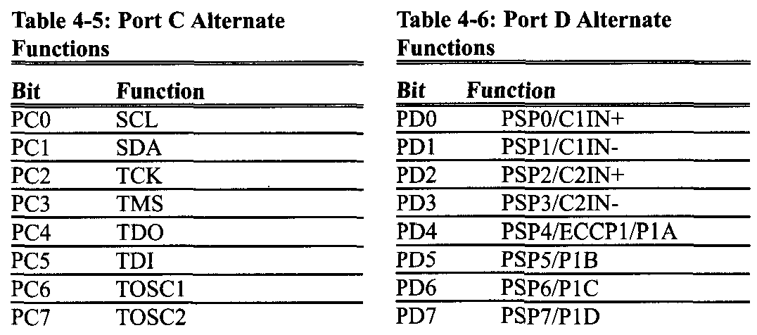
AVR I/O PORT PROGRAMMING 4.1 I/O PORT PROGRAMMING IN AVR
Dual role of Ports C and D
The alternate functions of the pins for Port C are shown in Table 4-5. The alternate functions of the pins for Port D are shown in Table 4-6.

Slide 23
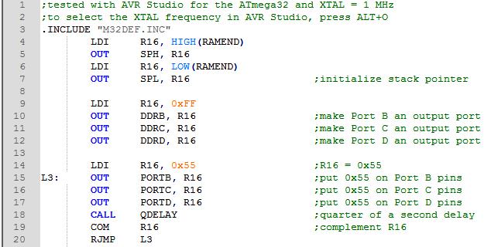
AVR I/O PORT PROGRAMMING 4.1 I/O PORT PROGRAMMING IN AVR
Example 4-1
Write a test program for the AVR chip to toggle all the bits of PORTB, PORTC, and PORTD every 1/4 of a second. Assume a crystal frequency of 1 MHz.
Solution:

Slide 24
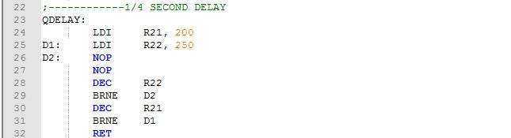
AVR I/O PORT PROGRAMMING 4.1 I/O PORT PROGRAMMING IN AVR
Calculations:
1 / 1 MHz = 1 µS
Delay = 200 × 250 × 5 MC × 1 µs = 250,000 µs (If we include the overhead, we will have 250,608 in. See Example 3-18 in the previous chapter.)
Use the AVR Studio simulator to verify the delay size.

Slide 25
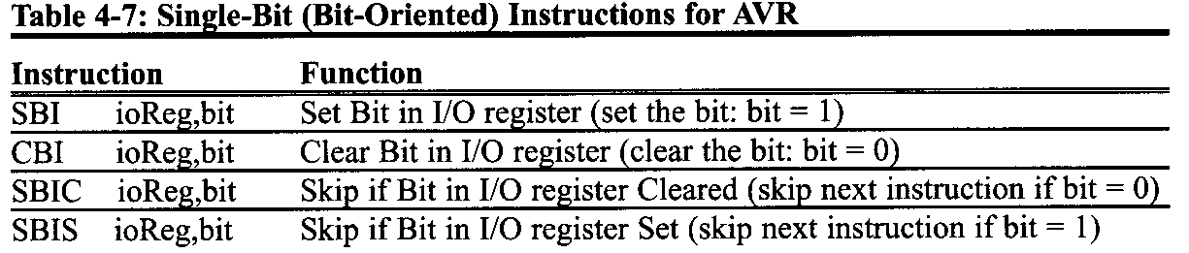
AVR I/O PORT PROGRAMMING 4.2: I/O BIT MANIPULATION PROGRAMMING
I/O ports and bit-addressability
Sometimes we need to access only 1 or 2 bits of the port instead of the entire 8 bits. A powerful feature of AVR I/O ports is their capability to access individual bits of the port without altering the rest of the bits in that port. Table 4-7 lists the single-bit instructions for the AVR.

Slide 26
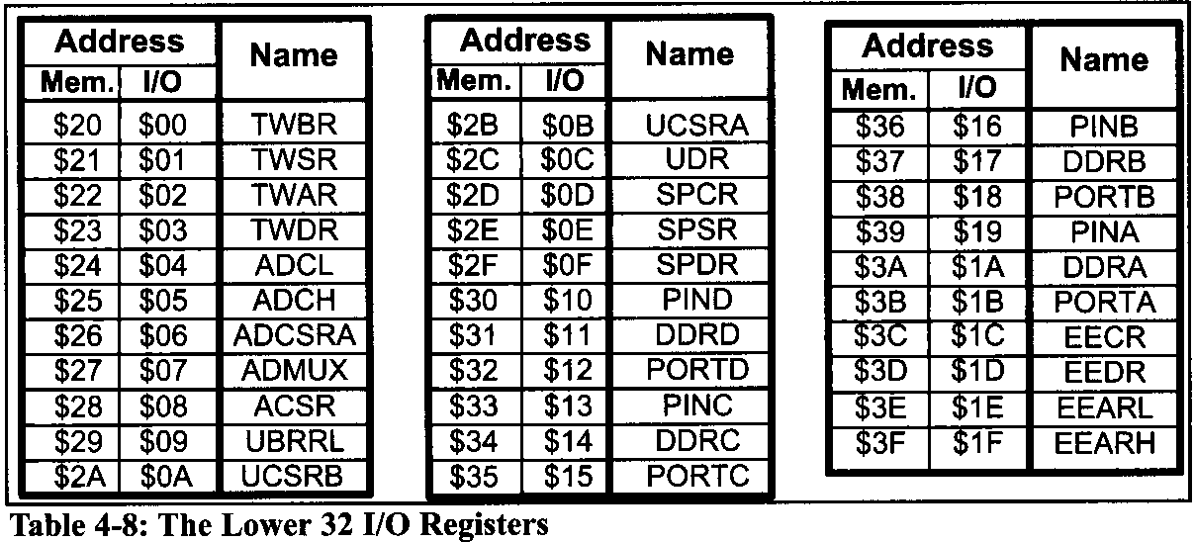
AVR I/O PORT PROGRAMMING 4.2: I/O BIT MANIPULATION PROGRAMMING
Although the instructions in Table 4-7 can be used for any of the lower 32 I/O registers, I/O port operations use them most often. We will see the use of these instructions throughout future chapters. Table 4-8 shows the lower 32 I/O registers

Slide 27
AVR I/O PORT PROGRAMMING 4.2: I/O BIT MANIPULATION PROGRAMMING
SBI (set bit in I/O register)
To set HIGH a single bit of a given I/O register, we use the following syntax:
SBI ioReg,bit num
where ioReg can be the lower 32 I/O registers (addresses 0 to 31) and bit_num is the desired bit number from 0 to 7. Although the bit-oriented instructions can be used for manipulation of bits D0-D7 of the lower 32 I/O registers, they are mostly used for I/O ports. For example the following instruction sets HIGH bit 5 of Port B:
SBI PORTB,5

Slide 28
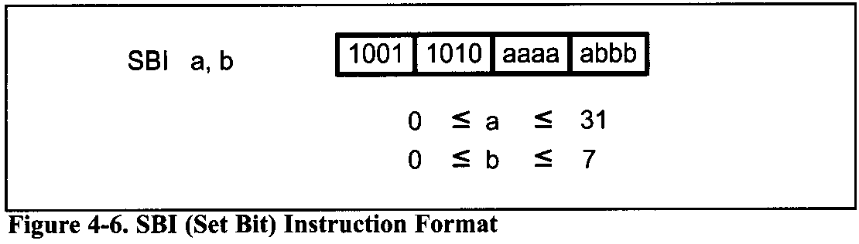
AVR I/O PORT PROGRAMMING 4.2: I/O BIT MANIPULATION PROGRAMMING
In Figure 4-6, you see the SBI instruction format.

Slide 29
AVR I/O PORT PROGRAMMING 4.2: I/O BIT MANIPULATION PROGRAMMING
CBI (Clear Bit in I/O register)
To clear a single bit of a given I/O register, we use the following syntax:
CBI ioReg,bit num
For example the following instruction toggles pin PB2 continuously:
SBI DDRB,2 ;bit =1,make PB2 an output
AGAIN: SBI PORTB,2 ;bit set (PB2=high)
call delay
CBI PORTB,2 ;bit clear (PB2=low)
call delay
RJMP AGAIN
Notes:
SBI DDRB, 2 ;bit = 1, make PB2 an output pin
AGA1N:SBI PORTB, 2 ;bit set (PB2 = high)
CALL DELAY
CBI PORTB, 2 ;bit clear (PB2 = low)
CALL DELAY
RJMP AGAIN

Slide 30
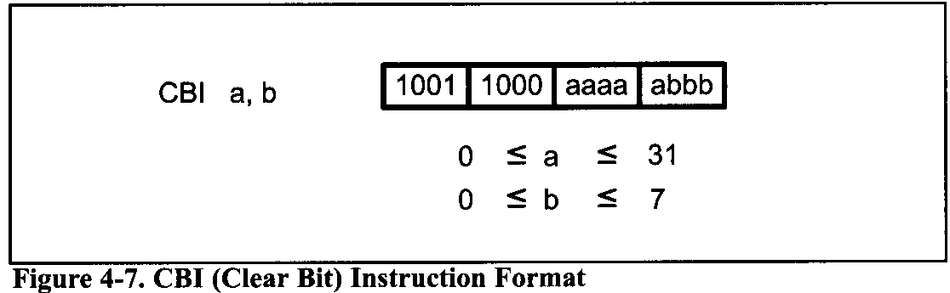
AVR I/O PORT PROGRAMMING 4.2: I/O BIT MANIPULATION PROGRAMMING
In Figure 4-7, you see the CBI instruction format.

Slide 31
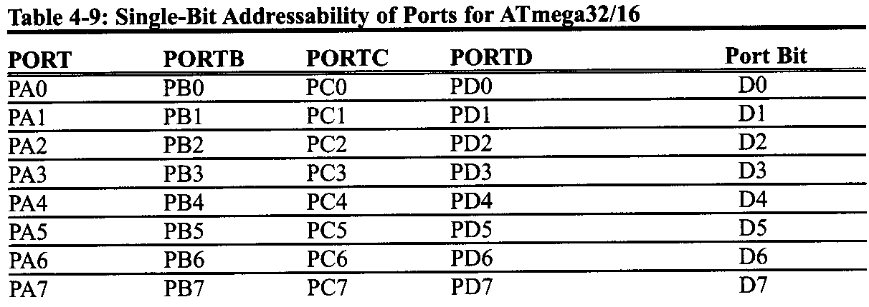
AVR I/O PORT PROGRAMMING 4.2: I/O BIT MANIPULATION PROGRAMMING
Notice that PB2 is the third bit of Port B (the first bit is PB0, the second bit is PB1, etc). This is shown in Table 4-9.

Slide 32
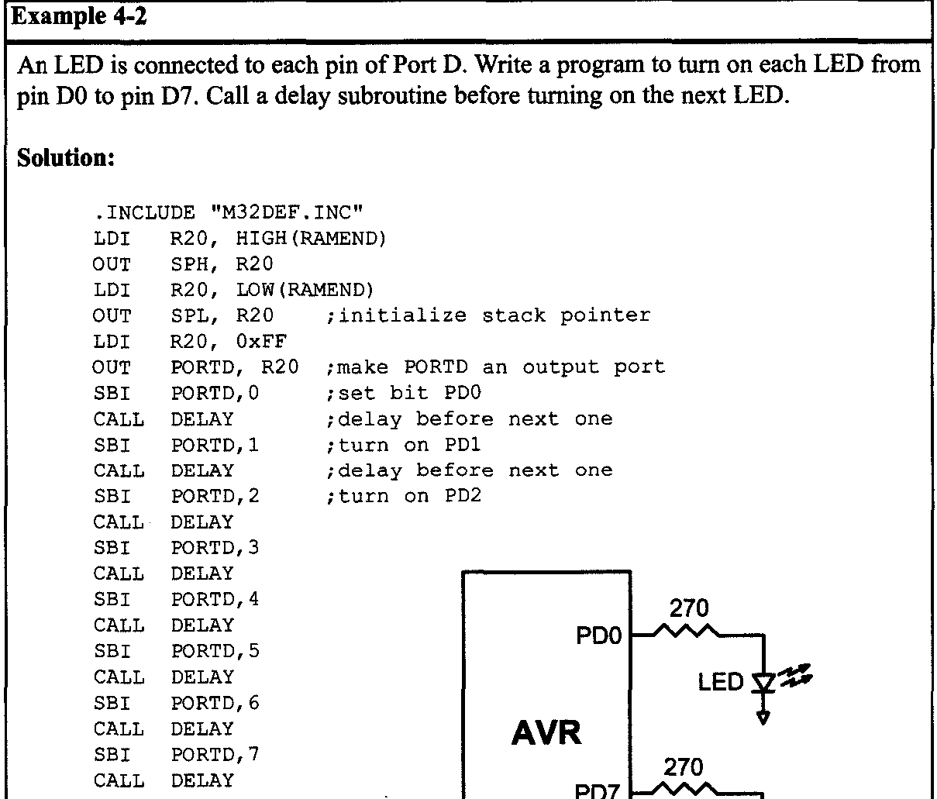
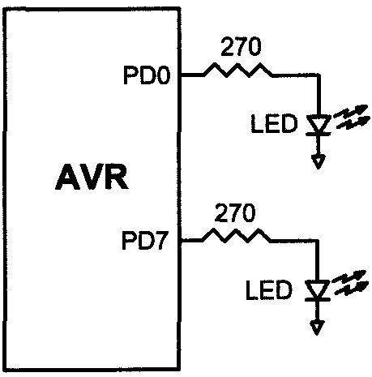
AVR I/O PORT PROGRAMMING 4.2: I/O BIT MANIPULATION PROGRAMMING

Slide 33
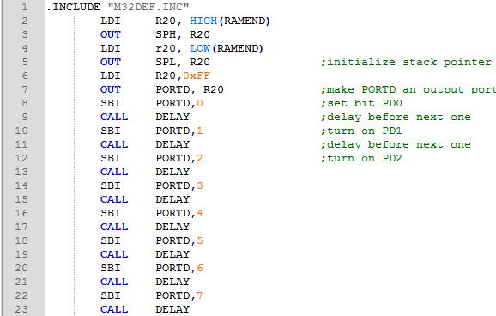
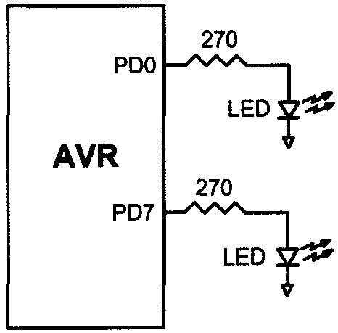
AVR I/O PORT PROGRAMMING 4.2: I/O BIT MANIPULATION PROGRAMMING
Example 4-2
An LED is connected to each pin of Port D. Write a program to turn on each LED from pin DO to pin D7. Call a delay subroutine before turning on the next LED.
Solution:

Slide 34
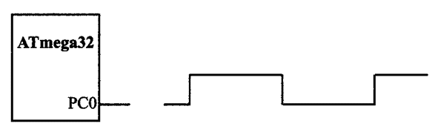
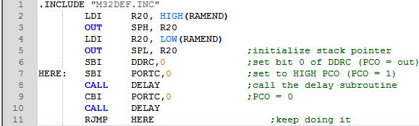
AVR I/O PORT PROGRAMMING 4.2: I/O BIT MANIPULATION PROGRAMMING
Example 4-3
Write the following programs: (a) Create a square wave of 50% duty cycle on bit 0 of Port C. (b) Create a square wave of 66% duty cycle on bit 3 of Port C.
Solution:
(a) The 50% duty cycle means that the "on" and "off" states (or the high and low portions of the pulse) have the same length. Therefore, we toggle PCO with a time delay between each state.

Slide 35
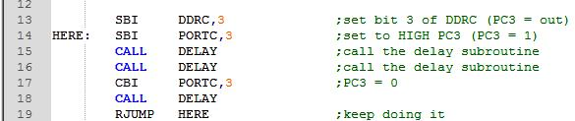
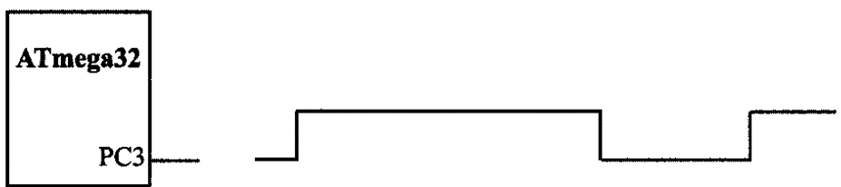
AVR I/O PORT PROGRAMMING 4.2: I/O BIT MANIPULATION PROGRAMMING
(b) A 66% duty cycle means that the "on" state is twice the "off" state.

Slide 36
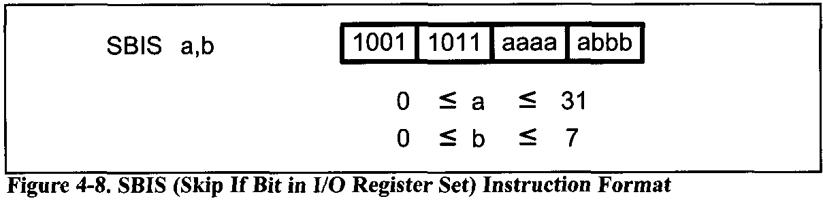
AVR I/O PORT PROGRAMMING 4.2: I/O BIT MANIPULATION PROGRAMMING
SBIS (Skip if Bit in I/O register Set)
To monitor the status of a single bit for HIGH, we use the SBIS instruction. This instruction tests the bit and skips the next instruction if it is HIGH.

Slide 37
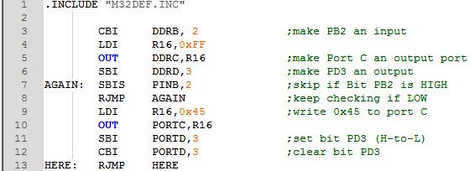
AVR I/O PORT PROGRAMMING 4.2: I/O BIT MANIPULATION PROGRAMMING
Example 4-4
Write a program to perform the following: (a) Keep monitoring the PB2 bit until it becomes HIGH; (b) When PB2 becomes HIGH, write the value $45 to Port C, and also send a HIGH-to-LOW pulse to PD3.
Solution:

Slide 38
AVR I/O PORT PROGRAMMING 4.2: I/O BIT MANIPULATION PROGRAMMING
In this program, "SBIS PINB, 2" instruction stays in the loop as long as PB2 is LOW. When PB2 becomes HIGH, it skips the branch instruction to get out of the loop, and writes the value $45 to Port C. It also sends a HIGH-to-LOW pulse to PD3.

Slide 39
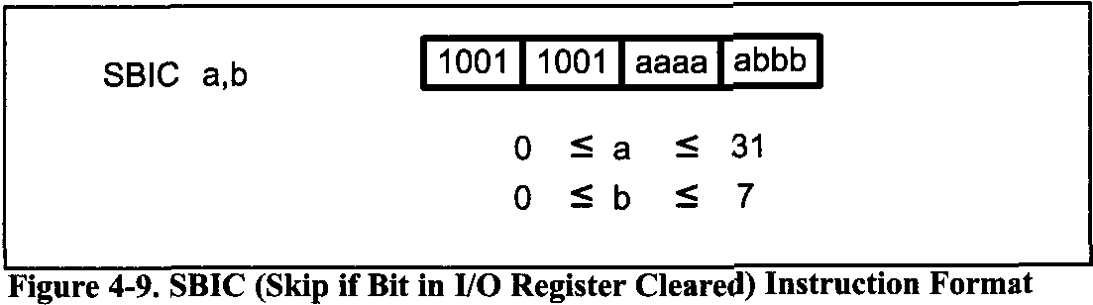
AVR I/O PORT PROGRAMMING 4.2: I/O BIT MANIPULATION PROGRAMMING
SBIC (Skip if Bit in I/O register Cleared)
To monitor the status of a single bit for LOW, we use the SBIC instruction. This instruction tests the bit and skips the instruction right below it if the bit is LOW.

Slide 40
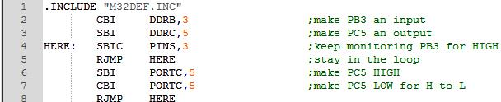
AVR I/O PORT PROGRAMMING 4.2: I/O BIT MANIPULATION PROGRAMMING
Example 4-5
Assume that bit PB3 is an input and represents the condition of a door alarm. If it goes LOW, it means that the door is open. Monitor the bit continuously. Whenever it goes LOW, send a HIGH-to-LOW pulse to port PC5 to turn on a buzzer.
Solution:

Slide 41
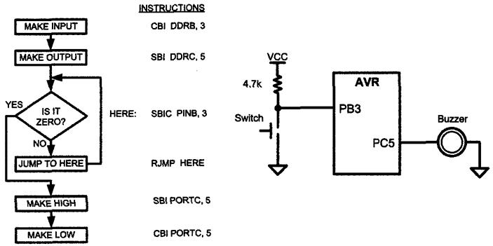
AVR I/O PORT PROGRAMMING 4.2: I/O BIT MANIPULATION PROGRAMMING

Slide 42
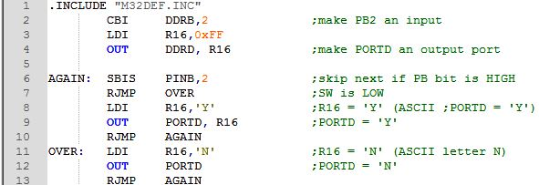
AVR I/O PORT PROGRAMMING 4.2: I/O BIT MANIPULATION PROGRAMMING
Example 4-b
A switch is connected to pin PB2. Write a program to check the status of SW and perform the following: (a) If SW = 0, send the letter 'N' to PORTD. (b) If SW = 1, send the letter 'Y' to PORTD.
Solution:

Slide 43
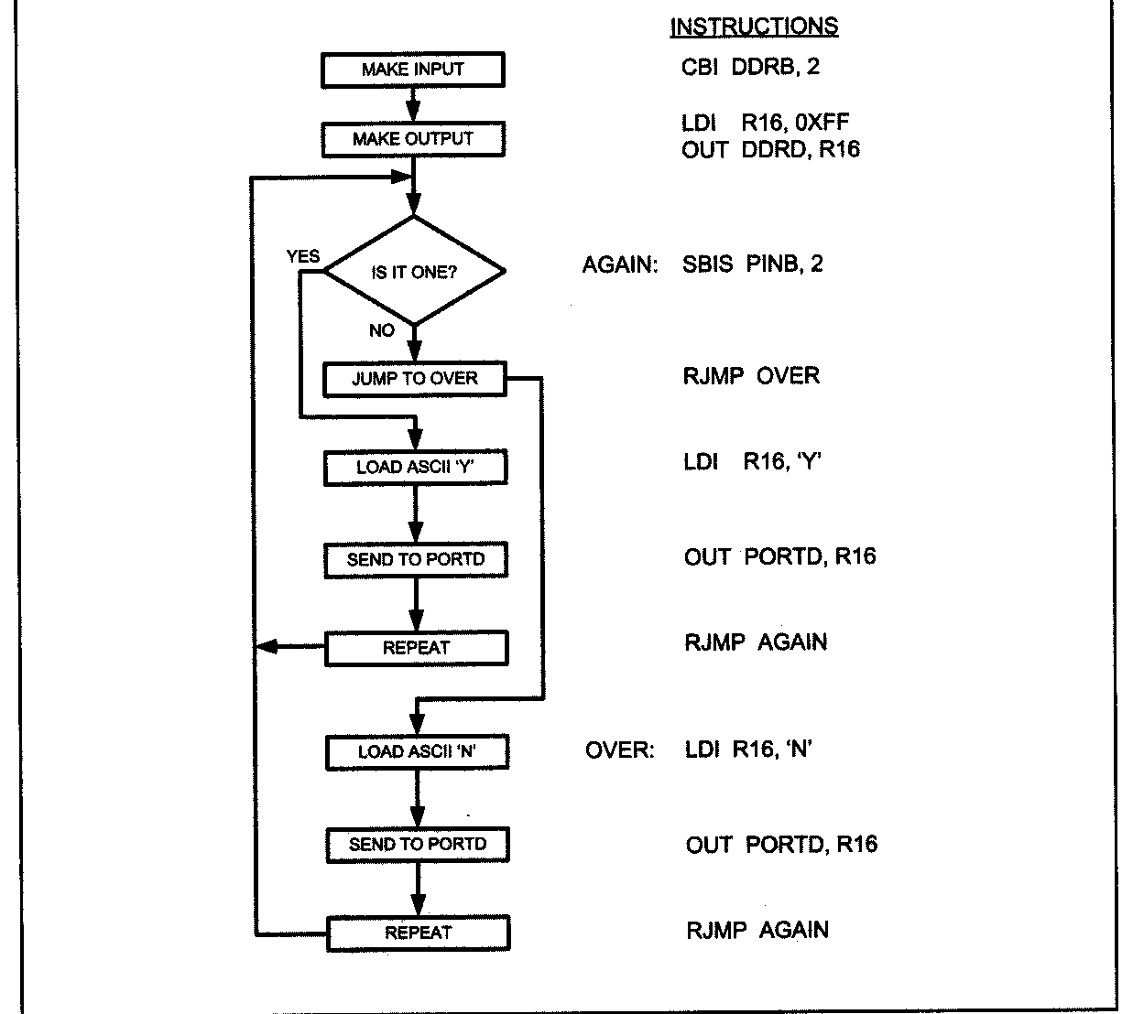
AVR I/O PORT PROGRAMMING 4.2: I/O BIT MANIPULATION PROGRAMMING

Slide 44
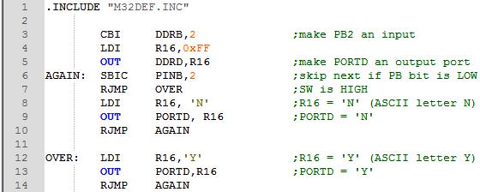
AVR I/O PORT PROGRAMMING 4.2: I/O BIT MANIPULATION PROGRAMMING
Example 4-7
Rewrite the program of Example 4-6, using the SBIC instruction instead of SBIS. Solution:

Slide 45
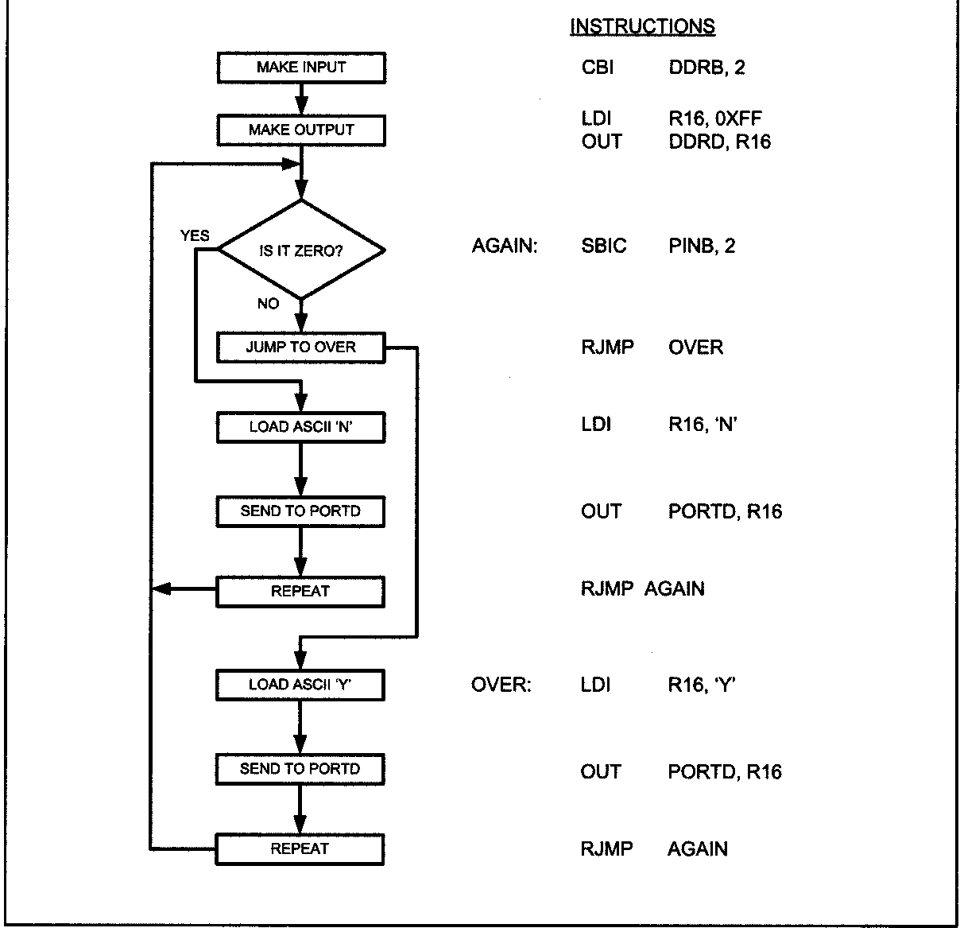
AVR I/O PORT PROGRAMMING 4.2: I/O BIT MANIPULATION PROGRAMMING

Slide 46
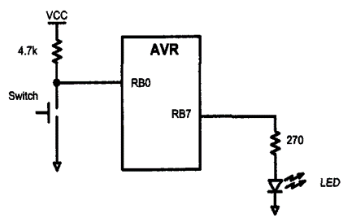
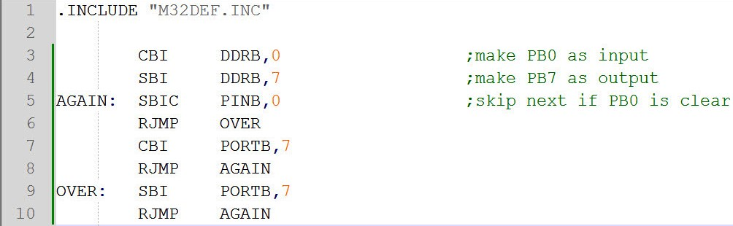
AVR I/O PORT PROGRAMMING 4.2: I/O BIT MANIPULATION PROGRAMMING
Reading a single bit
We can also use the bit test instructions to read the status of a single bit and send it to another bit or save it. This is shown in Examples 4-8 and 4-9.
Example 4-8
A switch is connected to pin PB0 and an LED to pin PB7. Write a program to get the status of SW and send it to the LED.
Solution:

